Slide 1

What's new in Flutter ?

Slide 2



Slide 3
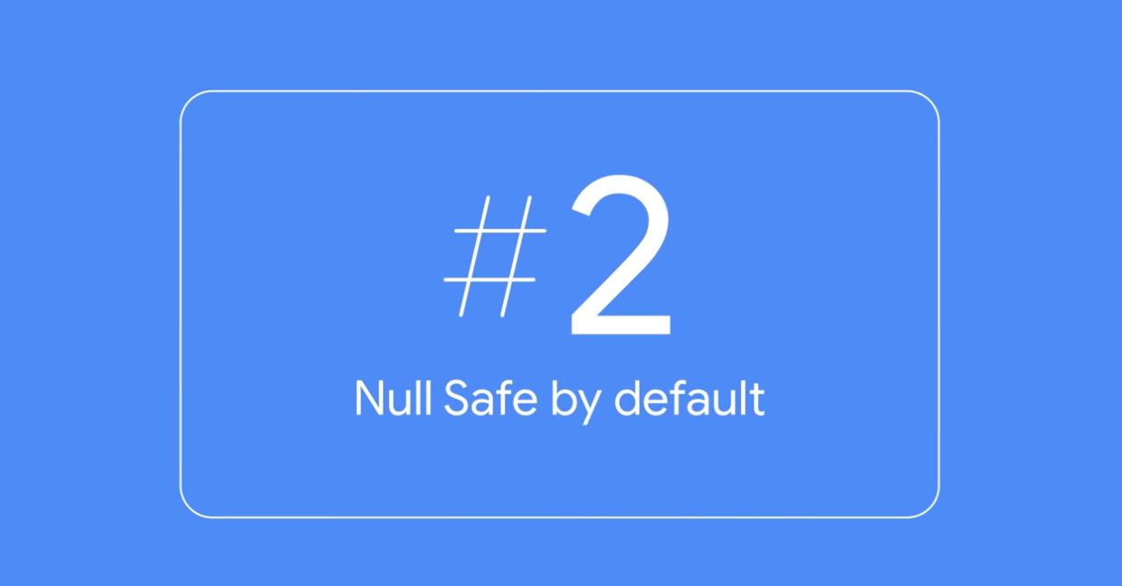

Slide 4
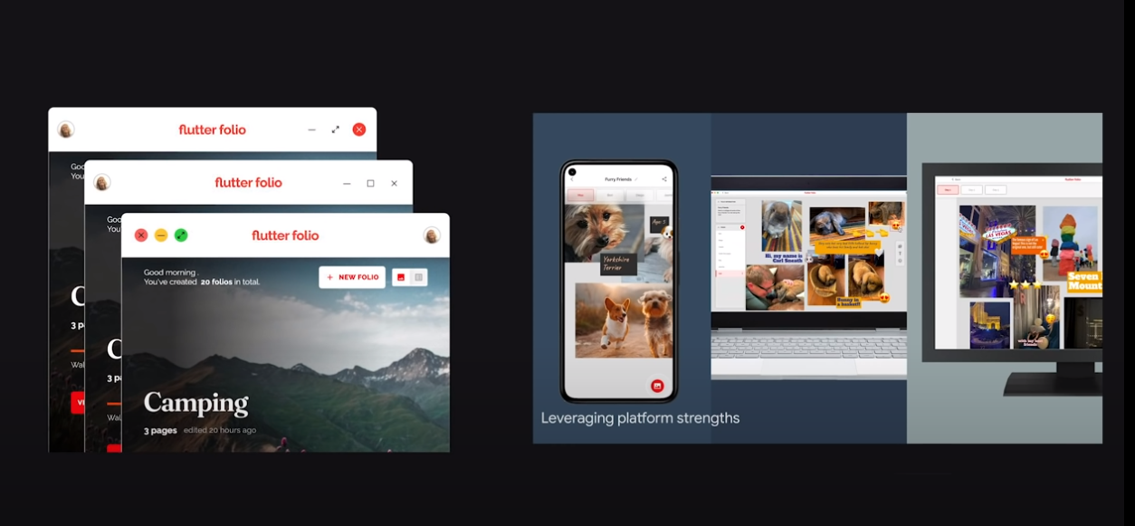
Desktop improvements

Slide 5
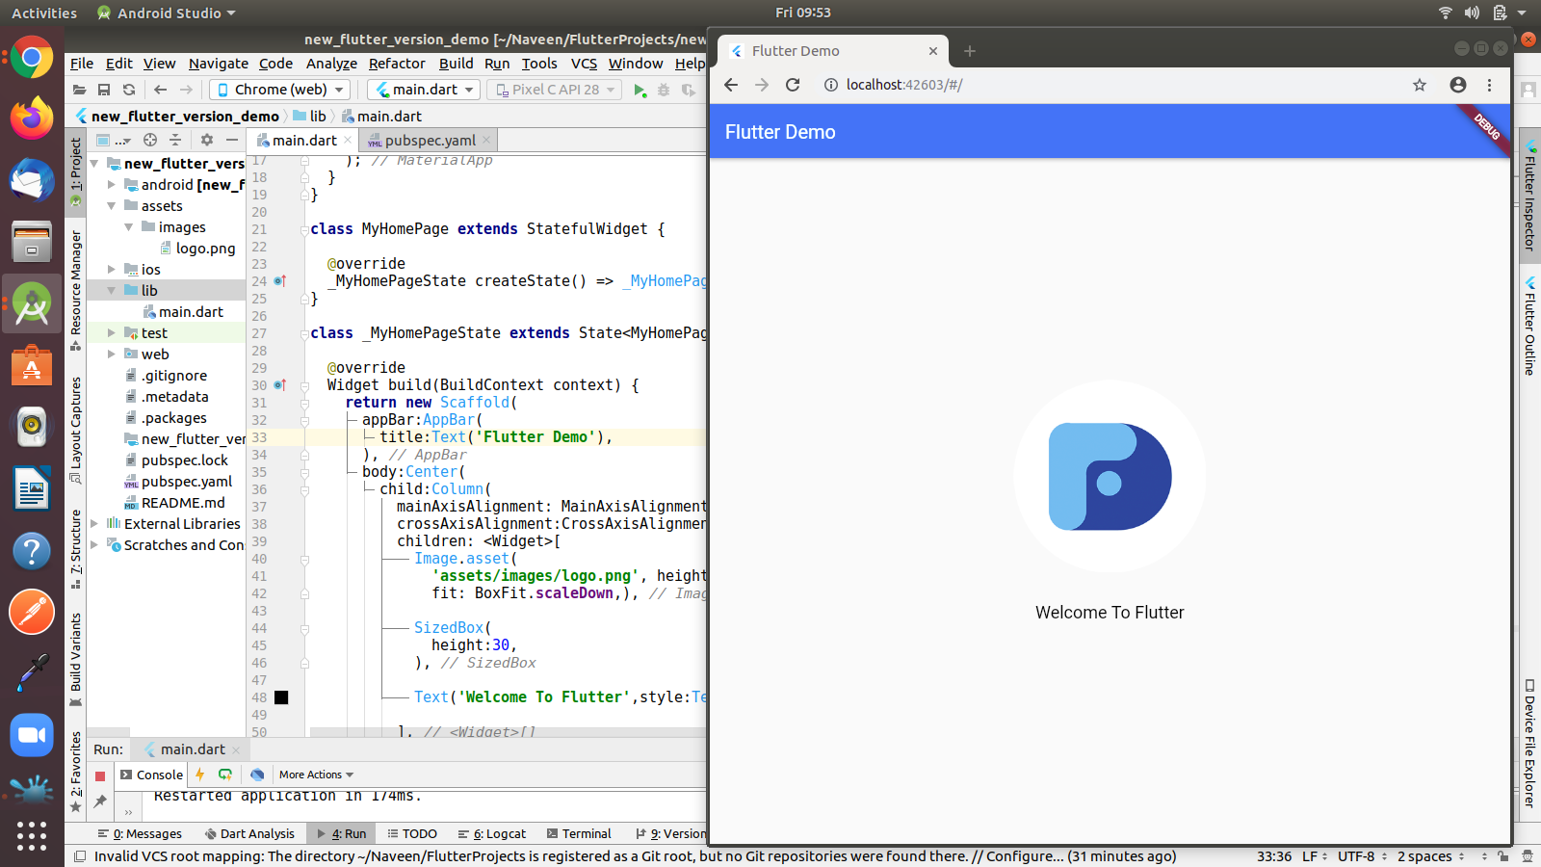
Flutter 2.2 Web Update

Slide 6


Slide 7
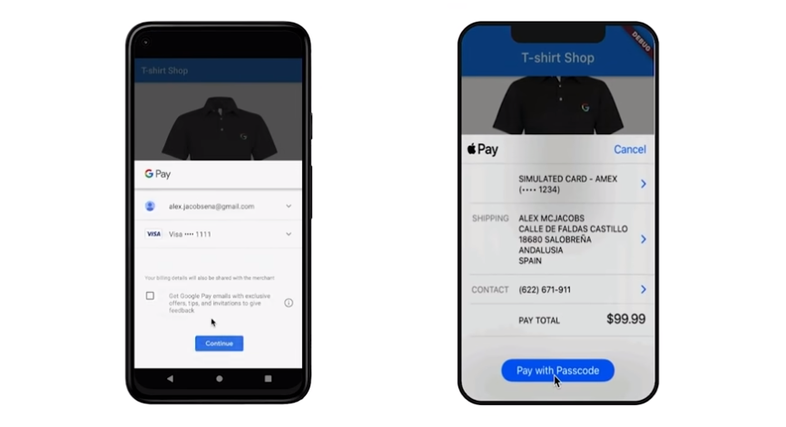
In App purchase

Slide 8
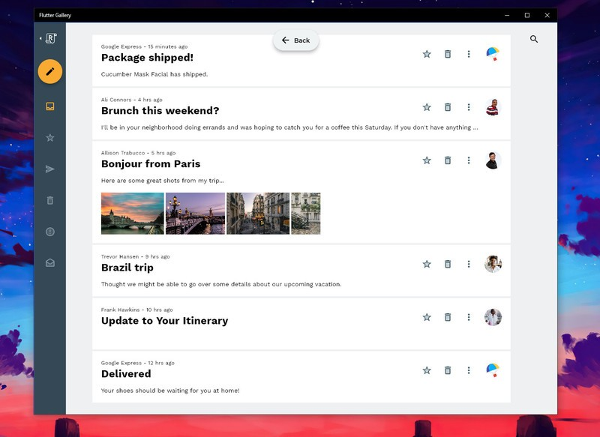
Flutter Windows UWP desktop support is an alpha release

Slide 9
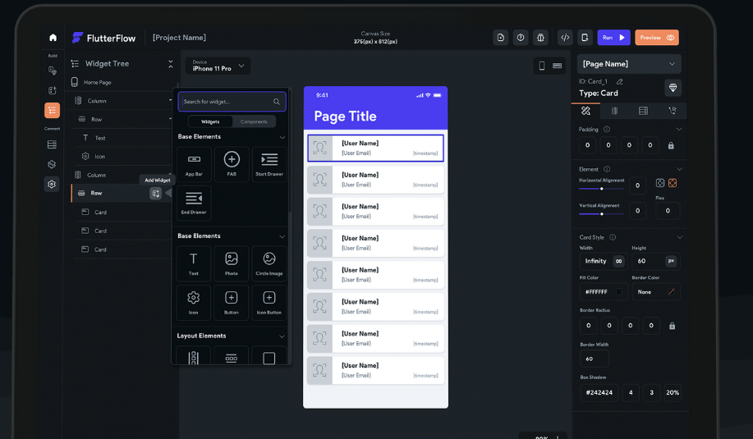
http://flutterflow.io/

